Slide 1
Lecture #1: Introduction to CS109A aka STAT121A, AC209A, CSCIE-109A

Slide 2
Lecture Outline
Why data science? Why taking CS109A?
What is data science?
What is this class and what it is not?
The data science process
Example

Slide 3
Why?
Jobs!

Slide 4
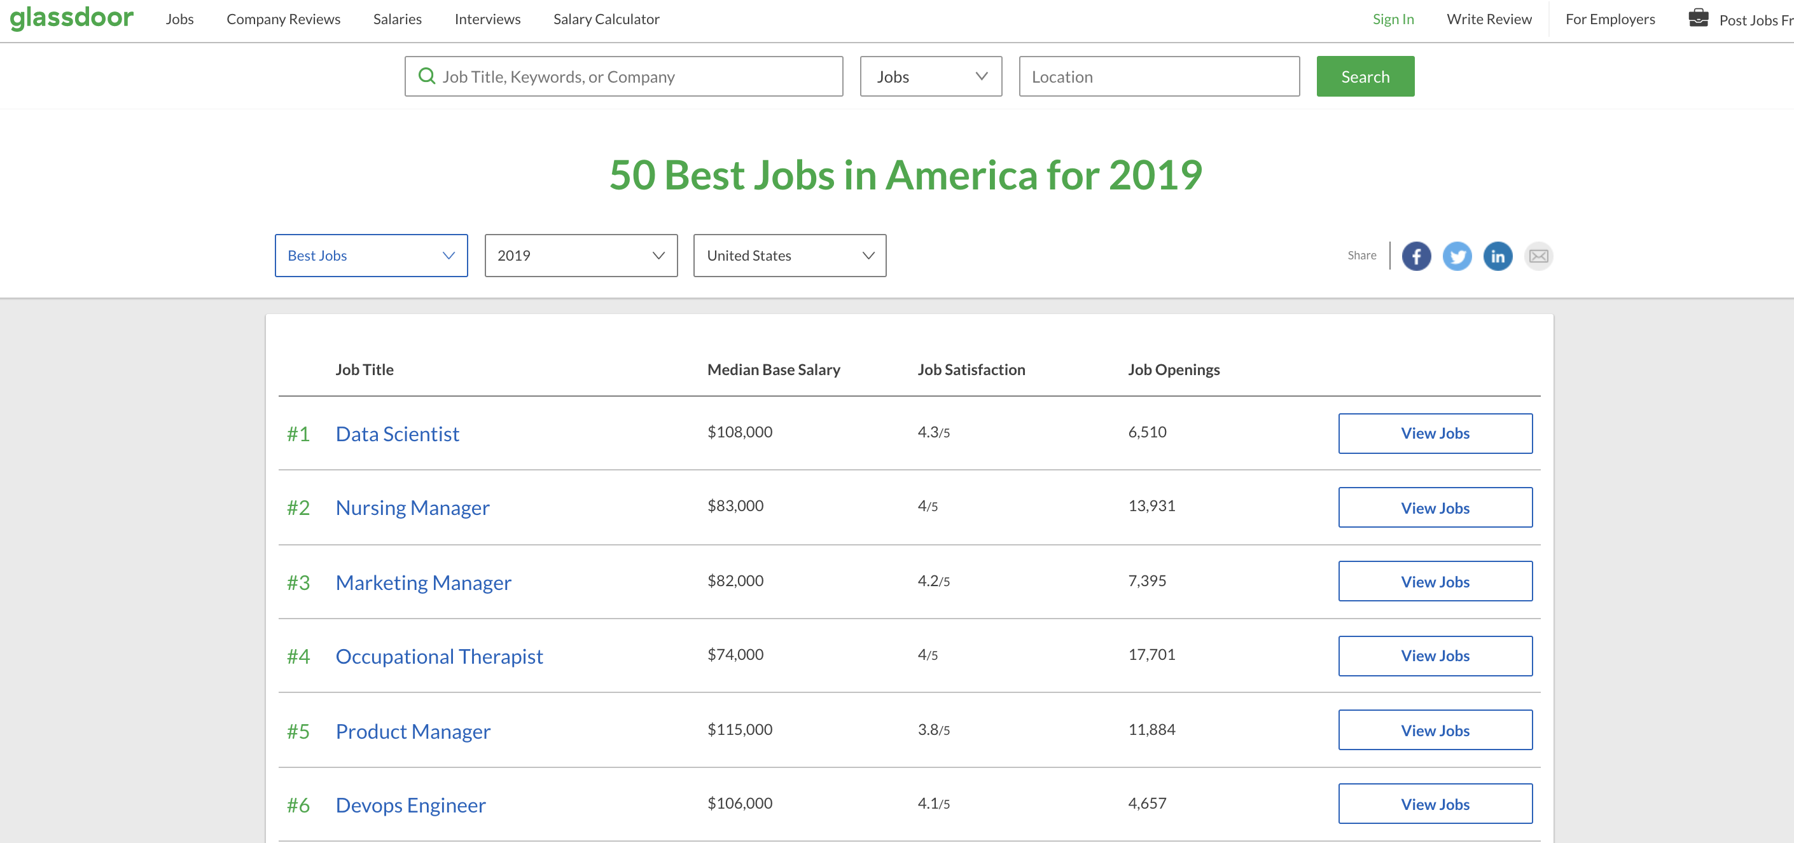
Why?
Jobs!

Slide 5
Why?
Jobs!

Slide 6
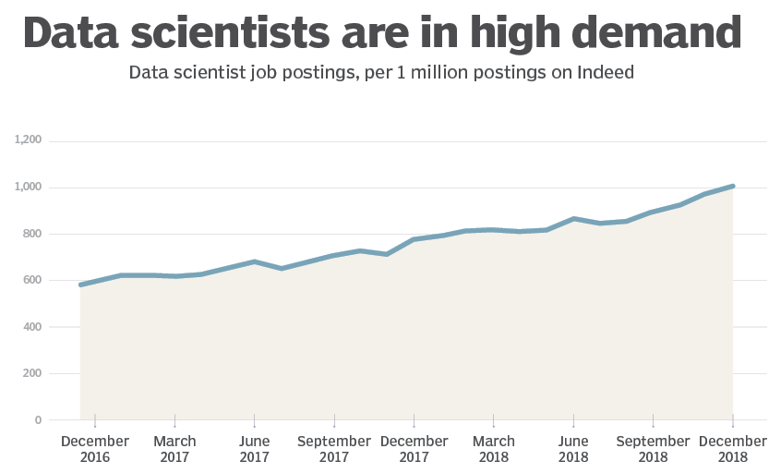
Why?

Slide 7
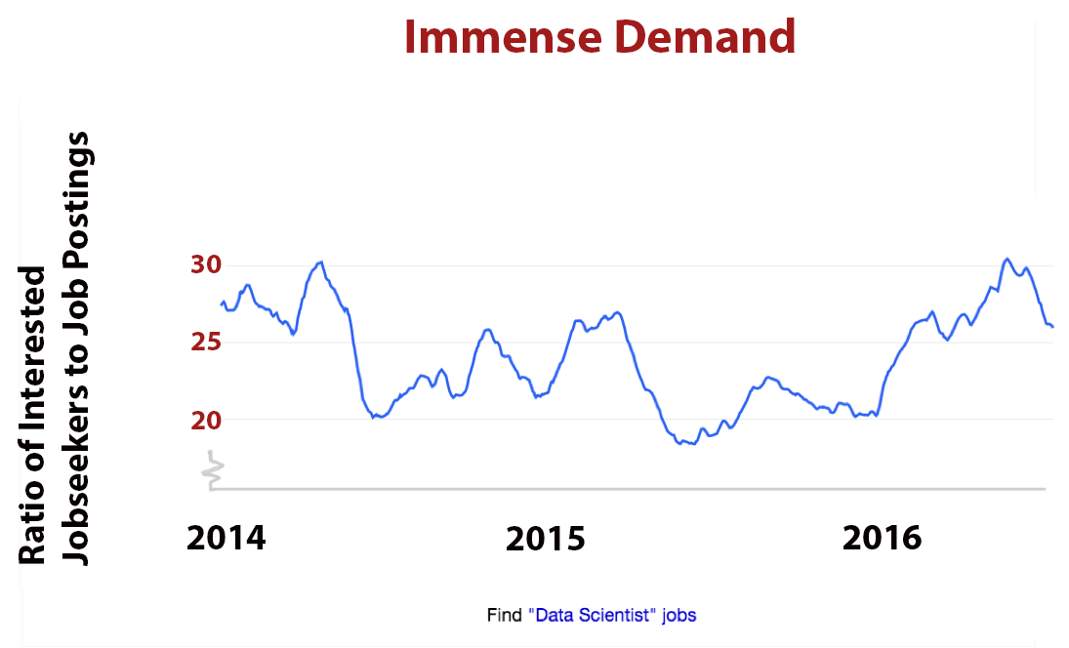
Why?

Slide 8
Why?
Why do I love data science?
Why are you here?

Slide 9
Why?

Slide 10
Why?
Why are you here?

Slide 11
A little bit of history

Slide 12
History
Long time ago (thousands of years) science was only
empirical and people counted stars

Slide 13
History (cont)
Long time ago (thousands of years) science was only
empirical and people counted stars or crops

Slide 14
History (cont)
Long time ago (thousands of years) science was only
empirical and people counted stars or crops and used the data to create machines to describe the phenomena
Notes:
Stonehedge: 3000 BC to 2000 BC. astronomical significance of the site for its people, are a matter of speculation and debate.
Antikithira mechanism 150 and 100 BC It is a complex clockwork mechanism composed of at least 30 meshing bronze gears.

Slide 15
History (cont)
Few hundred years: theoretical approaches, try to derive
equations to describe general phenomena.

Slide 16
History (cont)
About a hundred years ago: computational approaches
Notes:
Eniac

Slide 17
History (cont)
And then …. data science
Notes:
Eniac

Slide 18
What is data science?

Slide 19
What?
The Data Science Process
Ask an interesting question
Get the Data
Explore the Data
Model the Data
Communicate/Visualize the Results

Slide 20
What?
The Data Science Process
Ask an interesting question
What is the scientific goal?
What would you do if you had all of the data?
What do you want to predict or estimate?
Get the Data
Explore the Data
Model the Data
Communicate/Visualize the Results

Slide 21
What?
The Data Science Process
Ask an interesting question
How were the data sampled?
Which data are relevant?
Are there privacy issues?
Get the Data
Explore the Data
Model the Data
Communicate/Visualize the Results

Slide 22
What?
The Data Science Process
Ask an interesting question
Plot the data.
Are there anomalies or egregious issues?
Are there patterns?
Get the Data
Explore the Data
Model the Data
Communicate/Visualize the Results

Slide 23
What?
The Data Science Process
Ask an interesting question
Build a model.
Fit the model.
Validate the model.
Get the Data
Explore the Data
Model the Data
Communicate/Visualize the Results

Slide 24
What?
The Data Science Process
Ask an interesting question
What did we learn?
Do the results make sense?
Can we effectively tell a story?
Get the Data
Explore the Data
Model the Data
Communicate/Visualize the Results

Slide 25
What?
The material of the course will integrate the five key facets of an investigation using data:
data collection; data wrangling, cleaning, and sampling to get a suitable data set
data management; accessing data quickly and reliably
exploratory data analysis; generating hypotheses and building intuition
prediction or statistical learning
communication; summarizing results through visualization, stories, and interpretable summaries.

Slide 26
What?
Week 1:
Getting ready with python, jupyter notebooks, environments and numpy.

Slide 27
What?
Week 2:
Basic statistics, visualization, pandas and data scraping

Slide 28
What?
Week 3 and 4:
Regression, and sklearn using transportation data:
knn regression
Linear and Polynomial Regression
Multiple Regression
Model Selection
Regularization

Slide 29
What?
Week 5:
Exploratory Data Analysis, matplotlib and seaborn:
Basic concepts of EDA
Basic concepts of Visualization and Communications

Slide 30
What?
Week 6-7:
Classification, data imputations on Health Data:
Logistic Regression (linear and polynomial)
Multiple Logistic Regression
Missing data and knn classification

Slide 31
What?
Week 8:
EthiCS
PCA and high dimensionality

Slide 32
What?
Week 9 and 10:
Decisions trees and ensemble methods :
Simple Decision Trees for classification and Regression
Bagging
Random Forest
Boosting
Stacking

Slide 33
What?
Week 10-12:
Neural Networks:
Perceptron, Back Propagation and SGD
MLP and design choices
Advanced MLP, regularization, dropout, batch normalization
Neural Network solvers

Slide 34
What?
Week 12:
More visualization and model interpretation

Slide 35
What?
Week 13:
Experimental Design:
AB testing
Causal inference
Randomization testing
Adaptive and multi-arm bandit designs

Slide 36
CS109B
A. Neural Networks:
CNNs
RNNs
Generative models
B. Unsupervised Clustering
C. Piecewise Linear Regression
D. Bayesian Modeling

Slide 37
CS109C – Advanced Practical Data Science
A. Productions Data Science, from notebooks to the cloud
B. Big models, transfer learning and architecture learning
C. Visualization tools for interpreting models
D. Sequential data, seq2seq with attention, transformers, NLP and time series modeling

Slide 38
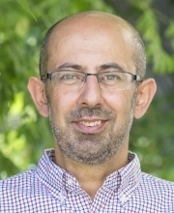
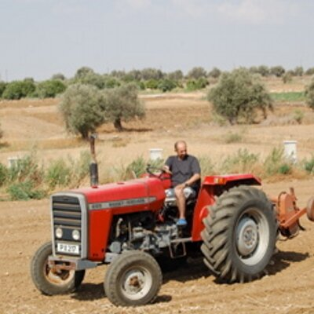
Who?
Pavlos Protopapas
Scientific Director of the Institute for Applied Computational Science (IACS)
Teaches CS109(a/b/c) and the data science capstone course.
Research in astrostatistics: machine learning, statistical learning, big data for astronomical problems. He is excited about the new telescopes coming online in the next few years. He has absolutely no hobbies or interests except teaching CS109 and eating.

Slide 39
Who? Instructor
Kevin Rader
Senior preceptor in Statistics. Teaches CS 109A & Stat 139 this fall and Stat 102 and Stat 98 in the spring.
Research interests include complex survey analysis and causal inference. Hobbies include the outdoors, sports
(especially the aquatic variety), and of course, farming.

Slide 40
Who? Instructor
Chris Tanner
Lecturer at IACS, teaching CS109A and AC297R (capstone) now, and CS109B in the Spring. Research interests are within Natural Language Processing and Deep Learning. Hobbies include hiking and camping, designing/sewing hiking bags, and photography.

Slide 41
Who? Lab instructors
Eleni Kaxiras
Eleni is the assist. Director for Data Science and Computation at SEAS. She has been this course’s Head TF for the last 3 years and she is now a lab instructor. She is currently a doctoral student. She is interested in the application of deep learning in analyzing biological signals. She owns olive trees in the island of Crete.

Slide 42

Who? Head TFs
Chris Gumb
Chris is currently working towards a graduate degree in Data Science from Harvard Extension School with a particular focus on NLP. His other interests and hobbies include: music theory & jazz improvisation; and film history.
Sol Girouard
She has been a head TF for 109B and
she is a Quant, Math-Econ and Data Scientist who channels her applied interdisciplinary background in the intersection of financial markets and technology. Tae kwon full contact second degree black belt.

Slide 43
Who? Teaching Fellows
Advanced Section (the 209 part):
Cedric Flamant
Section leaders: Marios Mattheakis
Robbert Struyven
Abhimanyu (Abhi) Vasishth

Slide 44
Who? Teaching Fellows
Rashmi Banthia Evan Mackay Brandon Walker Rachel Moon Nicholas Stern Pat Sukhum Zheyu Wu
Yun Bin (Matteo)Zhang Marcus Heijer Nathan Hollenberg Maddy Nakada Tim Pugh Alex Yu JavierMachin

Slide 45
Lectures, Labs, Advanced Sections, Sections and Office Hours
During lecture will cover the material which you will need to complete the homework, and to survive the rest of your life in CS109A. Attending lectures is required - quizzes during and at the end of each lecture (drop 50% of them).
We will use a mix of notes and examples via notebooks.
Lecture notes and associated notebooks will be posted before lecture on GitHub.
Lectures will be video taped (and live streamed for DCE students) and posted approximately within 24 hours on web page.
Mondays and Wednesdays 1:30-2:45pm @Northwest Building B103.

Slide 46
Lectures, Labs, Advanced Sections, Sections and Office Hours
Labs are meant to help you better understand the lecture materials via examples.
Labs will be video taped (and live streamed for DCE students) and posted approximately within 24 hours on Canvas.
Thursdays 4:30-5:45 pm @Pierce 301.

Slide 47
Lectures, Labs, Advanced Sections, Sections and Office Hours
Lectures and labs are supplemented by 1.5 hour sections led by teaching fellows. There are two types of sections:
Standard Sections will be a mix of review of material and practice problems similar to the homework
Friday 0:30-11:45 am at 1 Story St. Room 306 and Mon 4:30-5:45 pm in Science Center 110
Advanced Sections (A-Sections) will cover advanced topics like the mathematical underpinnings of the methods seen in lectures and labs.
Weds 4-5:15 pm at 1 Story St. Room 306

Slide 48
Lectures, Labs, Advanced Sections, Sections and Office Hours
Topics
Linear Algebra and Hypothesis Testing: The Short Versions
Methods of regularization and their justifications
Generalized Linear Models
Mathematics of PCA
Decision trees and Ensemble method;
Stochastic Gradient Descent
NOTE 1: The material covered in the Advanced Sections is required for all AC 209A students. There will be one extra question in most homework for AC 209 students which will be based on the A-Section materials.
NOTE 2: No additional quizzes for A-section.
NOTE 3: A-sections and Friday’s regular section will be live streamed to everyone.

Slide 49
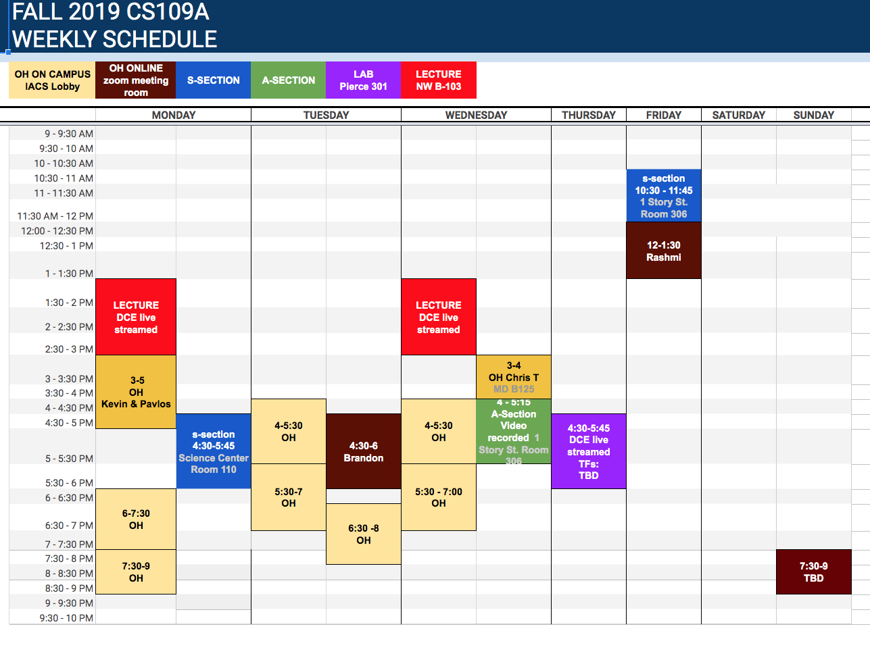
Lectures, Labs, Advanced Sections, Sections and Office Hours

Slide 50
Homework(s)
There will be 8 homework (not including Homework 0):
Homework 0 (due Sept 11)
Homework 1: Web scraping, Beautiful Soup
Homework 2: Regression kNN and LinReg
Homework 3: Multi-regression, polynomial reg and model selection
Homework 4*: Log Reg and more
Homework 5: PCA and ethics
Homework 6: Random Forest, Boosting and Neural Networks
Homework 7*: Neural Networks
Homework 8: Experimental Design

Slide 51
Homework(s)
You are encouraged but not required to submit in pairs, except homework 4 and homework 7, which must work individually.
We will be using the Groups function in Canvas to do this, details to be announced later.
All homework are due 11:59pm Wednesday and homework will be released on Wednesday 3:00pm.

Slide 52
Final Project
There will be a final group project (2-4 students) due during exams period.
We will provide 7 pre-defined projects which you could use for your final project.
In some very special cases you can use your own (public) data set and your own project definition (to be approved by the instructors)

Slide 53
Help

Slide 54
Help
The process to get help is:
Post the question in Ed and hopefully your peers will answer. We monitor the posts and we will respond within 8 hours from the posting time.
Go to Office Hours, this is the best way to get help.
For private matters send an email to the Helpline: cs109a2019@gmail.com. The Helpline is monitored by all the instructors and TFs.
For personal matters send an email to Pavlos, Kevin and Chris.
Sundays will be slow days, so please be patient!

Slide 55
Grades

Slide 56
Grades
Homework 0: 1%
Paired Homework (six): 39%
Individual Homework (two): 17%
Quizzes: 10%
Project: 30%
Participation: 3%
Total: 100%
We do not have predefined cuts for grades. We look for breaks in the cumulative distribution.

Slide 57
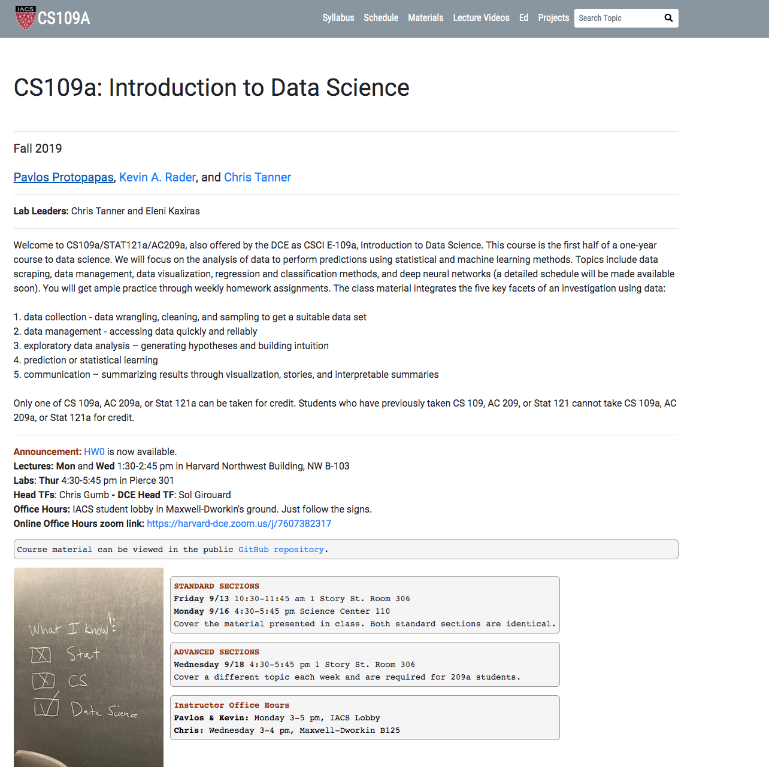

Slide 58
The Data Science Process

Slide 59
The Data Science Process
The Data Science Process is similar to the scientific process - one of observation, model building, analysis and conclusion:
Ask questions
Data Collection
Data Exploration
Data Modeling
Data Analysis
Visualization and Presentation of Results
Note: This process is by no means linear!

Slide 60
Analyzing Hubway Data
Introduction: Hubway is metro-Boston’s public bike share program, with more than 1600 bikes at 160+ stations across the Greater Boston area. Hubway is owned by four municipalities in the area.
By 2016, Hubway operated 185 stations and 1750 bicycles, with 5 million ride since launching in 2011.
The Data: In April 2017, Hubway held a Data Visualization Challenge at the Microsoft NERD Center in Cambridge, releasing 5 years of trip data.
The Question: What does the data tell us about the ride share program?

Slide 61
The Data Exploration/Question Refinement Cycle
Our original question: ‘What does the data tell us about the ride share program?’ is a reasonable slogan to promote a hackathon. It is not good for guiding scientific investigation.
Before we can refine the question, we have to look at the data!
Based on the data, what kind of questions can we ask?

Slide 62
The Data Exploration/Question Refinement Cycle
Who? Who’s using the bikes?
Refine into specific hypotheses:
More men or more women?
Older or younger people?
Subscribers or one time users?

Slide 63
The Data Exploration/Question Refinement Cycle
Where? Where are bikes being checked out?
Refine into specific hypotheses:
More in Boston than Cambridge?
More in commercial or residential?
More around tourist attractions?
Sometimes the data is given to you in pieces and must be merged!

Slide 64
The Data Exploration/Question Refinement Cycle
When? When are the bikes being checked out?
Refine into specific hypotheses:
More during the weekend than on the weekdays?
More during rush hour?
More during the summer than the fall?
Sometimes the feature you want to explore doesn’t exist in the data, and must be engineered!

Slide 65
The Data Exploration/Question Refinement Cycle
Why? For what reasons/activities are people
checking out bikes?
Refine into specific hypotheses:
More bikes are used for recreation than commute?
More bikes are used for touristic purposes?
Bikes are use to bypass traffic?
Do we have the data to answer these questions with reasonable certainty?
What data do we need to collect in order to answer these questions?

Slide 66
The Data Exploration/Question Refinement Cycle
How? Questions that combine variables.
How does user demographics impact the duration the bikes are being used? Or where they are being checked out?
How does weather or traffic conditions impact bike usage?
How do the characteristics of the station location affect the number of bikes being checked out?
How questions are about modeling relationships between different variables.

Slide 67
Inspirations for Data Viz/Exploration
So how well did we do in formulating creative hypotheses and manipulating the data for answers?
Check out the winners of the Hubway Challenge:
http://hubwaydatachallenge.org

